Slide 1
Dynamic ‘Slice’ Spectrum Sharing
Ravi Ravindran
(June 1st , 2021)

Slide 2
Problem
A Network Slice is a composition of 5G RAN, Core and Transport layer functions to meet a service’s SLA requirements.
The RAN itself is composed of a combination of CU-CP, CU-UP, DU and RU functions.
The user plane functions in CU-UP, DU and RU can be engineered to cater to different slice types
E.g. the PDCP/RLC/MAC/PHY layer features can be engineered to offer very low latency and high reliability required for URLLC PDUs
However, considering the cost of spectrum, this resource is expected to be shared among the different slice types.
Static or Semi-static mode of resource management could lead to low spectral utilization.

Slide 3
Problem
Joint scheduling is a difficult problem, schedulers optimized for one type of traffic is easier but tradeoff utilization.
With URLLC complex Pre-emption/Puncturing and DCI notification is required and Embb HARQ is affected requiring re-transmission
This invention tries to improve utilization while keeping the simplicity of keeping separate schedulers while allowing real-time interaction
Significant literature addressing this
Disjoint scheduling
In this approach, the DUs managing different slice traffic could interact in near real-time to exchange slice level traffic statistics with other DUs and agree on a spectrum resource sharing considering the Priority among of the different slices.
DSS operates at the RAT level, here we exploit this idea at the slice level among DUs
The invention solves the problem of enabling multiple DU handling different Slice traffic (e.g. PODs in the same server) to interact in realtime and agreeing on a PRB resource distribution using the algorithm proposed in the invention.
The algorithm can also be operated in a centralized manner

Slide 4



System View (with Disjoint Scheduling)
We assume different types of UEs being served by multiple DUs (e.g implemented as PODs in the same physical server)
The spectrum resources are also shared among the DUs and its UEs in the cell
Multiple slices with different SLA requirements are being served
DRBs are set up between CU/DU to transfer user data in the UL/DL.
The Data DRBs are routed through the same RU, in a way that the resources are orthogonally shared among the UEs.
URLCC users have low latency 3-9ms RAN delay requirement and 10⁻⁴ PER requirement, hence these mission critical flows have highest priority in the system.
UPF
DNN
CU-CP
CU-UP
Slice-x
Slice-z
Slice-y
DU
(EMBB)
DU(URLLC)
DU (mmtc)
DU Server
RU

Slide 5
Key Idea – System View
SON (Slice Manager)
EMbb DRBs
F1
URLLC DRBs
F1
DU (Embb)
Traffic Estimator
Slice Policy
Traffic Estimator
Slice Policy
F1-Ap/RLC Buffers
F1-Ap/RLC Buffer
MAC DL/UL Schedular
CQI
CQI
MAC DL/UL Schedular
UL/DL PRB Resource Management
UL/DL PRB Resource Mgmt + PRB Mgmt. Algorithm
[PRB Reservation]
DU (URLLC)
PHY
PHY

Slide 6
System - Functional Details
Traffic estimator interfaces with the MAC function and estimates the average arrivals across DRB/UE over X*TTIs.
This can be aggregated over the active UEs to determine the total arrivals across X*TTI.
TE also estimates total DL buffer occupancy across all the UEs in the DU
The UL/DL PRB resource mgmt. function, uses the Average Arrival/Buffer packet statistics from the TE and maps it to equivalent PRB level statistics considering UE channel conditions and the target BLER.
The global Slice Policy is shared across DUs and has information related to the type of slice work in the other DUs and the policies related to resource sharing,
e.g. X% of total PRB resources can be reserved for eMBB/MMTC so that they are not starved
The URLLC DU has the highest priority in terms of resource reservation, but shouldn’t exceed the aggregate policy requirements of other lower priority DRB

Slide 7
PRB Estimation Algorithm
Master DU
[URLLC]
Two level slices, URLLC has the highest priority and the remaining slices are considered equal
The resource PRB reservation can be synced among DUs every X TTIs
The DU handling the URLLC traffic is the master node. The other DUs (EMBB and MMTC) shares its PRB requirement every X TTIs with DU(URLLC)
Every X TTIs the DU(URLLC) executes the following steps, the results is applied at the t_{o} + X*TTI:
[Embb PRB Requirment]
[MMTC PRB Requirement]
[URLLC PRB Filter]
DU
[EMBB]
DU
[MMTC]
PRB(URLLC)
t₀
t_{o} + X*TTI
DU URLLC
Embb(Arrival Rate, Buffer)
PRB_{filter}(Embb)
t₀
DU Embb
Mmtc(Arrival Rate, Buffer)
PRB_{filter}(Mmtc)
t₀
DU MMTC

Slide 8
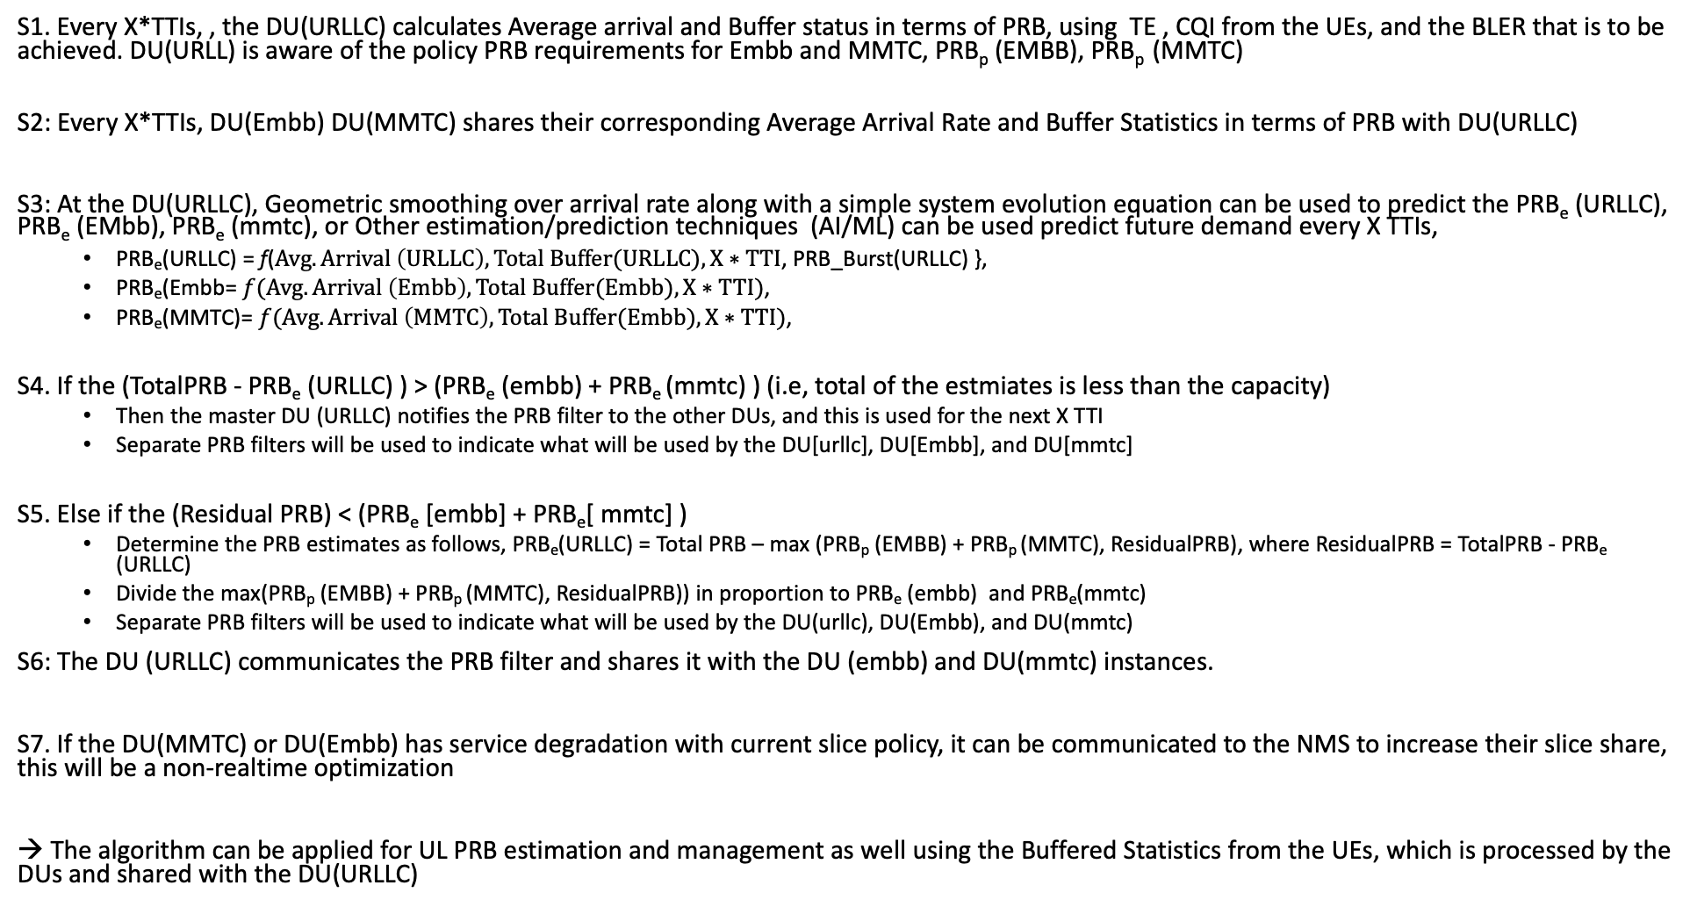
DL/UL PRB Estimation Algorithm
S1. Every X*TTIs, , the DU(URLLC) calculates Average arrival and Buffer status in terms of PRB, using TE , CQI from the UEs, and the BLER that is to be achieved. DU(URLL) is aware of the policy PRB requirements for Embb and MMTC, PRB_{p} (EMBB), PRB_{p} (MMTC)
S2: Every X*TTIs, DU(Embb) DU(MMTC) shares their corresponding Average Arrival Rate and Buffer Statistics in terms of PRB with DU(URLLC)
S3: At the DU(URLLC), Geometric smoothing over arrival rate along with a simple system evolution equation can be used to predict the PRB_{e} (URLLC), PRB_{e} (EMbb), PRB_{e} (mmtc), or Other estimation/prediction techniques (AI/ML) can be used predict future demand every X TTIs,
PRB_{e}(URLLC) = f($Avg. Arrival \left(URLLC\right), Total Buffer(URLLC), X∗TTI$, PRB_Burst(URLLC) },
PRB_{e}(Embb= $f(Avg. Arrival \left(Embb\right), Total Buffer(Embb), X∗TTI)$,
PRB_{e}(MMTC)= $f(Avg. Arrival \left(MMTC\right), Total Buffer(Embb), X∗TTI)$,
S4. If the (TotalPRB - PRB_{e} (URLLC) ) > (PRB_{e} (embb) + PRB_{e} (mmtc) ) (i.e, total of the estmiates is less than the capacity)
Then the master DU (URLLC) notifies the PRB filter to the other DUs, and this is used for the next X TTI
Separate PRB filters will be used to indicate what will be used by the DU[urllc], DU[Embb], and DU[mmtc]
S5. Else if the (Residual PRB) < (PRB_{e} [embb] + PRB_{e}[ mmtc] )
Determine the PRB estimates as follows, PRB_{e}(URLLC) = Total PRB – max (PRB_{p} (EMBB) + PRB_{p} (MMTC), ResidualPRB), where ResidualPRB = TotalPRB - PRB_{e} (URLLC)
Divide the max(PRB_{p} (EMBB) + PRB_{p} (MMTC), ResidualPRB)) in proportion to PRB_{e} (embb) and PRB_{e}(mmtc)
Separate PRB filters will be used to indicate what will be used by the DU(urllc), DU(Embb), and DU(mmtc)
S6: The DU (URLLC) communicates the PRB filter and shares it with the DU (embb) and DU(mmtc) instances.
S7. If the DU(MMTC) or DU(Embb) has service degradation with current slice policy, it can be communicated to the NMS to increase their slice share, this will be a non-realtime optimization
→ The algorithm can be applied for UL PRB estimation and management as well using the Buffered Statistics from the UEs, which is processed by the DUs and shared with the DU(URLLC)

Slide 9
Generalized Scenario
vCU
vCU
URLLC
MMTC
URLLC
MMTC
EMBB
URLLC
EMBB
DU Server
A leader can be selected among the same type of slice DUs
The leader DU aggregates the requirements from other similar DUs
The previous algorithm now works among the elected leaders
The URLLC DU acts as the unit that makes decision on
[PRB Reservation]
[PRB Reservation]
Leader
MMTC
Master
URLLC
Leadar
EMBB
Sub- MMTC
Sub- MMTC
Sub- URLLC
Sub- URLLC
Sub- URLLC
Sub- EMBB
Sub- EMBB

Slide 10
RIC Based Solution
A1
Non-RT RIC
Near-RT RIC
A1
Slice RM (Xapp)
Near-RT RIC
(Slice RM –Xapp)
Slice PRB Estimation Algo.
Slice Policy
In this framework, there is a Slice-RM XApp in the Near-RT RIC.
The XApp’s subscribe to DRB level statistics such as Arrival Rate, Buffer Data for the DU (URLLC, Embb, MMTC) in terms of PRB
The XApps then uses the Total PRB capacity information, along with current demand for URLLC and other slices , and the slice policy to decide the PRB allocation in the next X*TTI
PRB estimation algorithm in Slide 8 can be executed by the XApp
The X*TTI now has to account for the communication delay between the delay
One benefit with RIC based approach is, non-RAN metrics such as location, UE mobility pattern can be taken into account while estimating the future PRB allocations.
E2
E2
E2
E2
DU[URLLC]
E2
E2
Traffic Estimator
UL/DL PRB Resource Management
DU[Embb]
vCU
UPF
DU (URLLC)
RLC/MAC
DRBs
E2
F1
PRB(URLLC)
DU[MMTC]
t_{o} + X*TTI
t₀
Xapp (Slice RM)
t₀
PRB_{Filter}(MMTC)
DU (URLLC)
t₀
PRB_{filter} (MMTC)
DU (EMBB)
t₀
PRB_{filter} (MMTC)
DU (MMTC)

Slide 11
PRB Estimation Algorithm

Slide 12

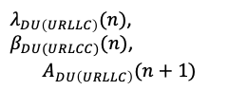
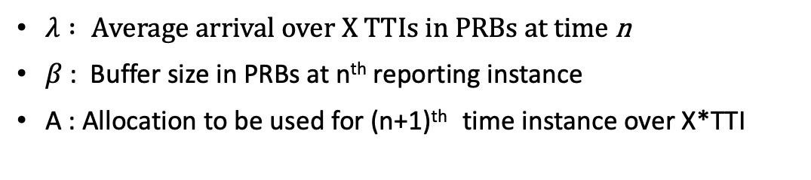

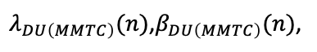
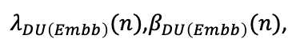
PRB Estimation Algorithm
X*TTI
DU URLLC
n
n+1
DU(Embb)
Embb(Arrival Rate, Buffer)
PRB_{filter}(Embb)
t₀
DU Embb
TE
Mmtc(Arrival Rate, Buffer)
PRB_{filter}(Mmtc)
DU URLLC
t₀
DU MMTC
X*TTI
$λ_{DU\left(Embb\right)}(n)$,$β_{DU\left(Embb\right)}(n)$,
PRB Mgmt .+ Algo.
Slice Policy
PRB Mgmt.
$$A_{DU\left(Embb\right)}(n+1)$$
$λ_{DU\left(URLLC\right)}(n)$,$β_{DU(URLCC)}(n)$,
$$A_{DU\left(URLLC\right)}(n+1)$$
$λ_{DU\left(MMTC\right)}(n)$,$β_{DU\left(MMTC\right)}(n)$,
TE
RLC/MAC
DU(MMTC)
TE
X*TTI
$$A_{DU\left(MMTC\right)}(n+1)$$
X*TTI
$λ : A$verage arrival over X TTIs in PRBs at time n
$β$ : Buffer size in PRBs at n^{th} reporting instance
A : Allocation to be used for (n+1)^{th} time instance over X*TTI
PRB Mgmt.

Slide 13
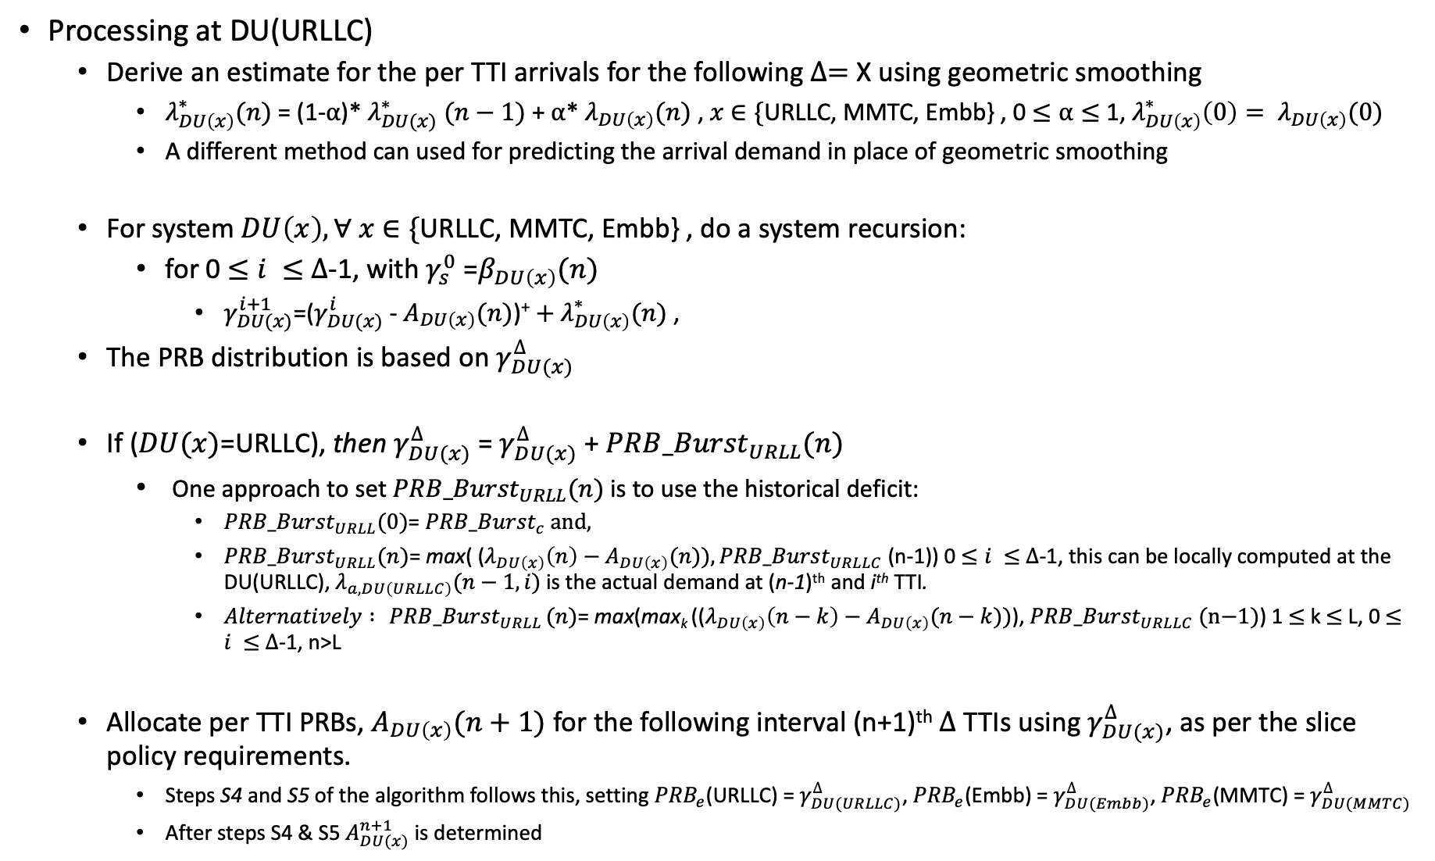
PRB Estimation Algorithm
Processing at DU(URLLC)
Derive an estimate for the per TTI arrivals for the following $∆=$X using geometric smoothing
$λ_{DU\left(x\right)}^{∗}(n)$= (1-⍺)* $λ_{DU(x)}^{∗}$ $(n−1)$ + ⍺* $λ_{DU\left(x\right)}(n)$ , $x$ $∈\{$URLLC, MMTC, Embb} , 0 $≤\text{⍺}≤$ 1, $λ_{DU\left(x\right)}^{∗}\left(0\right)= λ_{DU\left(x\right)}(0)$
A different method can used for predicting the arrival demand in place of geometric smoothing
For system $DU\left(x\right), ∀ x$ $∈\{$URLLC, MMTC, Embb} , do a system recursion:
for 0 $≤i ≤$ $∆$-1, with $γ_{s}^{0}$ =$β_{DU\left(x\right)}(n)$
$γ_{DU(x)}^{i+1}$=($γ_{DU(x)}^{i}$ - $A_{DU\left(x\right)}(n)$)⁺ ${+ λ}_{DU\left(x\right)}^{∗}(n)$ ,
The PRB distribution is based on $γ_{DU(x)}^{∆}$
If ($DU(x)$=URLLC), then $γ_{DU(x)}^{∆}$ = $γ_{DU(x)}^{∆}$ + ${PRB_Burst}_{URLL}(n)$
One approach to set ${PRB_Burst}_{URLL}(n)$ is to use the historical deficit:
${PRB_Burst}_{URLL}(0)$= ${PRB_Burst}_{c} \text{and},$
${PRB_Burst}_{URLL}(n)$= max( ($λ_{DU\left(x\right)}\left(n\right)−A_{DU\left(x\right)}(n)), {PRB_Burst}_{URLLC}$(n-1)) 0 $≤i ≤$ $∆$-1, this can be locally computed at the DU(URLLC), $λ_{a, DU\left(URLLC\right)}(n−1,i)$ is the actual demand at (n-1)^{th} and i^{th} TTI.
$Alternatively :{ PRB_Burst}_{URLL}(n)$= max(max_{k} (($λ_{DU\left(x\right)}\left(n−k\right)−A_{DU\left(x\right)}(n−k))$), ${PRB_Burst}_{URLLC} \text{(}\text{n}\text{−1)}$) 1 $≤$ k $≤$ L, 0 $≤i ≤$ $∆$-1, n>L
Allocate per TTI PRBs, $A_{DU\left(x\right)}(n+1)$ for the following interval (n+1)^{th} $∆$ TTIs using $γ_{DU(x)}^{∆}$, as per the slice policy requirements.
Steps S4 and S5 of the algorithm follows this, setting ${PRB}_{e}$(URLLC) = $γ_{DU(URLLC)}^{∆}$, ${PRB}_{e}$(Embb) = $γ_{DU(Embb)}^{∆}$, ${PRB}_{e}$(MMTC) = $γ_{DU(MMTC)}^{∆}$
After steps S4 & S5 $A_{DU(x)}^{n+1}$ is determined

Slide 14

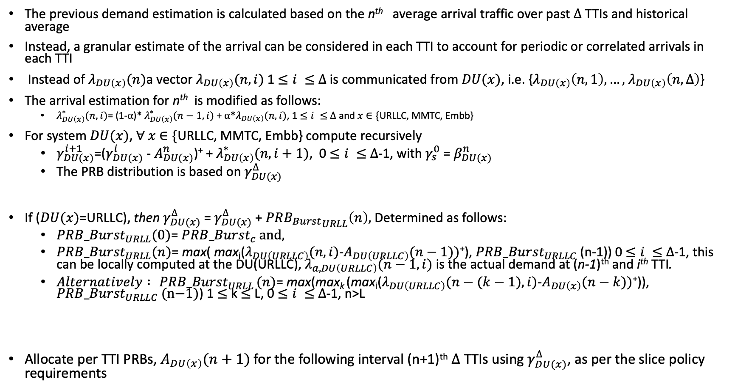
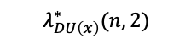

Algorithm Enhancement (1) – Using Arrival Vectors
The previous demand estimation is calculated based on the n^{th} average arrival traffic over past $∆$ TTIs and historical average
Instead, a granular estimate of the arrival can be considered in each TTI to account for periodic or correlated arrivals in each TTI
Instead of $λ_{DU\left(x\right)}(n)$a vector $λ_{DU\left(x\right)}(n,i)$ 1 $≤i ≤$ $∆$ is communicated from $DU(x)$, i.e. {$λ_{DU\left(x\right)}\left(n,1\right),…,$ $λ_{DU\left(x\right)}\left(n,∆\right)$}
The arrival estimation for n^{th} is modified as follows:
$λ_{DU\left(x\right)}^{∗}(n,i)$= (1-⍺)* $λ_{DU\left(x\right)}^{∗}(n−1,i)$+ ⍺*$λ_{DU\left(x\right)}(n,i)$, 1 $≤i ≤$ $∆$ and $x$ $∈\{$URLLC, MMTC, Embb}
For system $DU(x)$, $∀ x$ $∈\{$URLLC, MMTC, Embb} compute recursively
$γ_{DU(x)}^{i+1}$=($γ_{DU(x)}^{i}$ - $A_{DU(x)}^{n}$)⁺ + $λ_{DU\left(x\right)}^{∗}(n,i+1)$, 0 $≤i ≤$ $∆$-1, with $γ_{s}^{0}$ = $β_{DU(x)}^{n}$
The PRB distribution is based on $γ_{DU(x)}^{∆}$
If ($DU(x)$=URLLC), then $γ_{DU(x)}^{∆}$ = $γ_{DU(x)}^{∆}$ + ${PRB_{Burst}}_{URLL}\left(n\right),$ Determined as follows:
${PRB_Burst}_{URLL}(0)$= ${PRB_Burst}_{c} \text{and},$
${PRB_Burst}_{URLL}(n)$= max( max_{i}($λ_{DU\left(URLLC\right)}(n,i)$-$A_{DU\left(URLLC\right)}(n−1))$⁺), ${PRB_Burst}_{URLLC}$(n-1)) 0 $≤i ≤$ $∆$-1, this can be locally computed at the DU(URLLC), $λ_{a, DU\left(URLLC\right)}(n−1,i)$ is the actual demand at (n-1)^{th} and i^{th} TTI.
$Alternatively :{ PRB_Burst}_{URLL}(n)$= max(max_{k} (max_{i}($λ_{DU\left(URLLC\right)}(n−(k−1),i)$-$A_{DU\left(x\right)}(n−k))$⁺)), ${PRB_Burst}_{URLLC}\text{ (}\text{n}\text{−1)}$) 1 $≤$ k $≤$ L, 0 $≤i ≤$ $∆$-1, n>L
Allocate per TTI PRBs, $A_{DU\left(x\right)}(n+1)$ for the following interval (n+1)^{th} $∆$ TTIs using $γ_{DU(x)}^{∆}$, as per the slice policy requirements
$$λ_{DU\left(x\right)}^{∗}(n,i)$$
$$λ_{DU\left(x\right)}^{∗}(n,2)$$
$$λ_{DU\left(x\right)}^{∗}(n,∆)$$
n

Slide 15
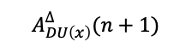

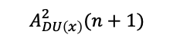
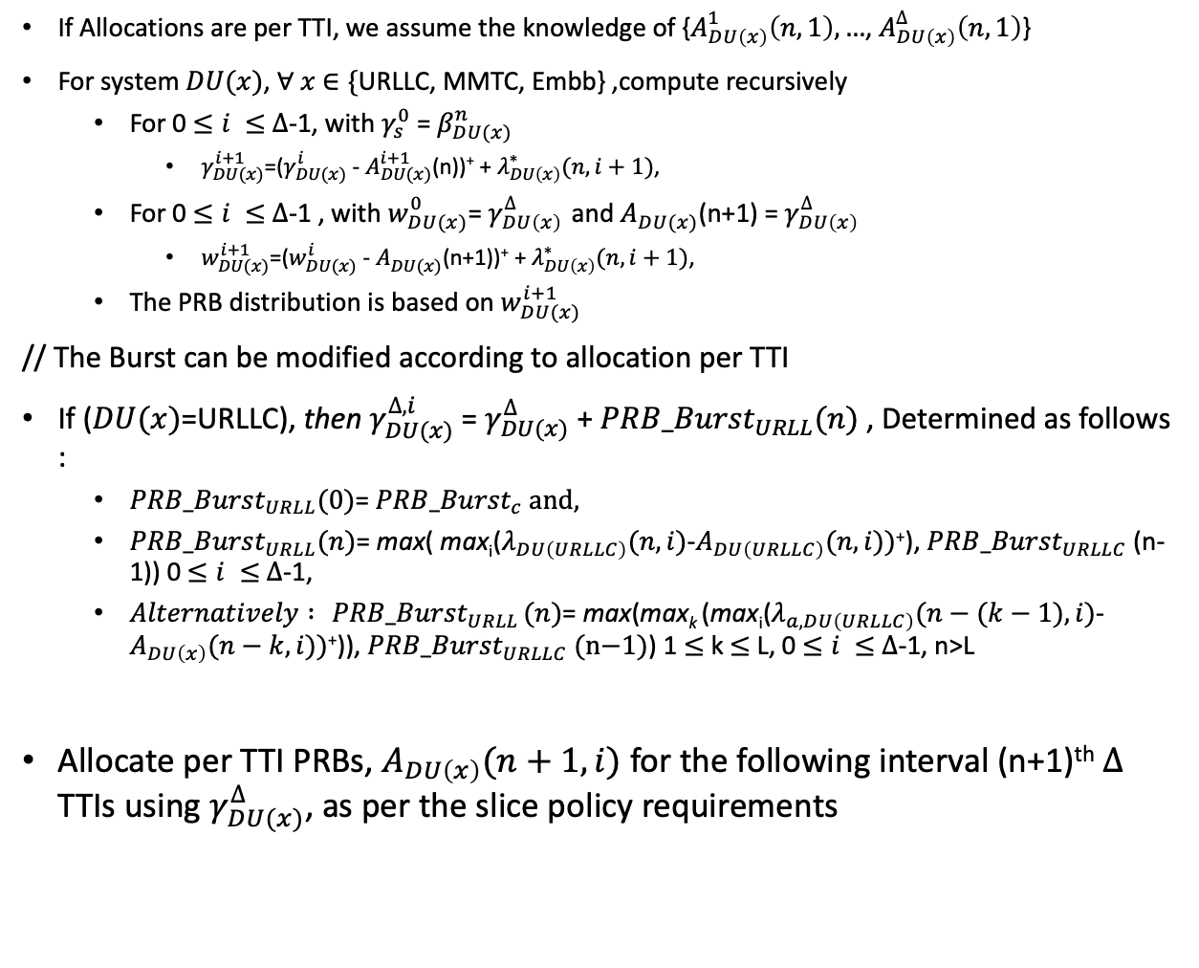
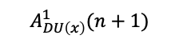


Algorithm Enhancement (2): Vector Allocation using Vector Arrivals
If Allocations are per TTI, we assume the knowledge of {$A_{DU\left(x\right)}^{1}\left(n,1\right), …$, $A_{DU\left(x\right)}^{∆}\left(n,1\right)$}
For system $DU(x)$, $∀ x$ $∈\{$URLLC, MMTC, Embb} ,compute recursively
For 0 $≤i ≤$ $∆$-1, with $γ_{s}^{0}$ = $β_{DU(x)}^{n}$
$γ_{DU(x)}^{i+1}$=($γ_{DU(x)}^{i}$ - $A_{DU(x)}^{i+1}$(n))⁺ + $λ_{DU\left(x\right)}^{∗}(n,i+1)$,
For 0 $≤i ≤$ $∆$-1 , with $w_{DU(x)}^{0}$= $γ_{DU\left(x\right) }^{∆}$and $A_{DU(x)}^{}$(n+1) = $γ_{DU\left(x\right) }^{∆}$
$w_{DU(x)}^{i+1}$=($w_{DU(x)}^{i}$ - $A_{DU(x)}^{}$(n+1))⁺ + $λ_{DU\left(x\right)}^{∗}(n,i+1)$,
The PRB distribution is based on${ w}_{DU(x)}^{i+1}$
// The Burst can be modified according to allocation per TTI
If ($DU(x)$=URLLC), then $γ_{DU(x)}^{∆,i}$ = $γ_{DU(x)}^{∆}$ + ${PRB_Burst}_{URLL}(n)$ , Determined as follows :
${PRB_Burst}_{URLL}(0)$= ${PRB_Burst}_{c} \text{and},$
${PRB_Burst}_{URLL}(n)$= max( max_{i}($λ_{DU\left(URLLC\right)}(n,i)$-$A_{DU\left(URLLC\right)}(n,i))$⁺), ${PRB_Burst}_{URLLC}$(n-1)) 0 $≤i ≤$ $∆$-1,
$Alternatively :{ PRB_Burst}_{URLL}(n)$= max(max_{k} (max_{i}($λ_{a, DU\left(URLLC\right)}(n−(k−1),i)$-$A_{DU\left(x\right)}(n−k,i))$⁺)), ${PRB_Burst}_{URLLC}\text{ (}\text{n}\text{−1)}$) 1 $≤$ k $≤$ L, 0 $≤i ≤$ $∆$-1, n>L
Allocate per TTI PRBs, $A_{DU\left(x\right)}(n+1, i)$ for the following interval (n+1)^{th} $∆$ TTIs using $γ_{DU(x)}^{∆}$, as per the slice policy requirements
$$λ_{DU\left(x\right)}^{∗}(n,∆)$$
$$λ_{DU\left(x\right)}^{∗}(n,i)$$
$$λ_{DU\left(x\right)}^{∗}(n,2)$$
n
n+1
n+1
n+2
$$A_{DU\left(x\right)}^{1}(n+1)$$
$$A_{DU\left(x\right)}^{2}(n+1)$$
$$A_{DU\left(x\right)}^{∆}(n+1)$$

Slide 16
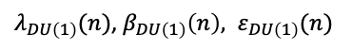
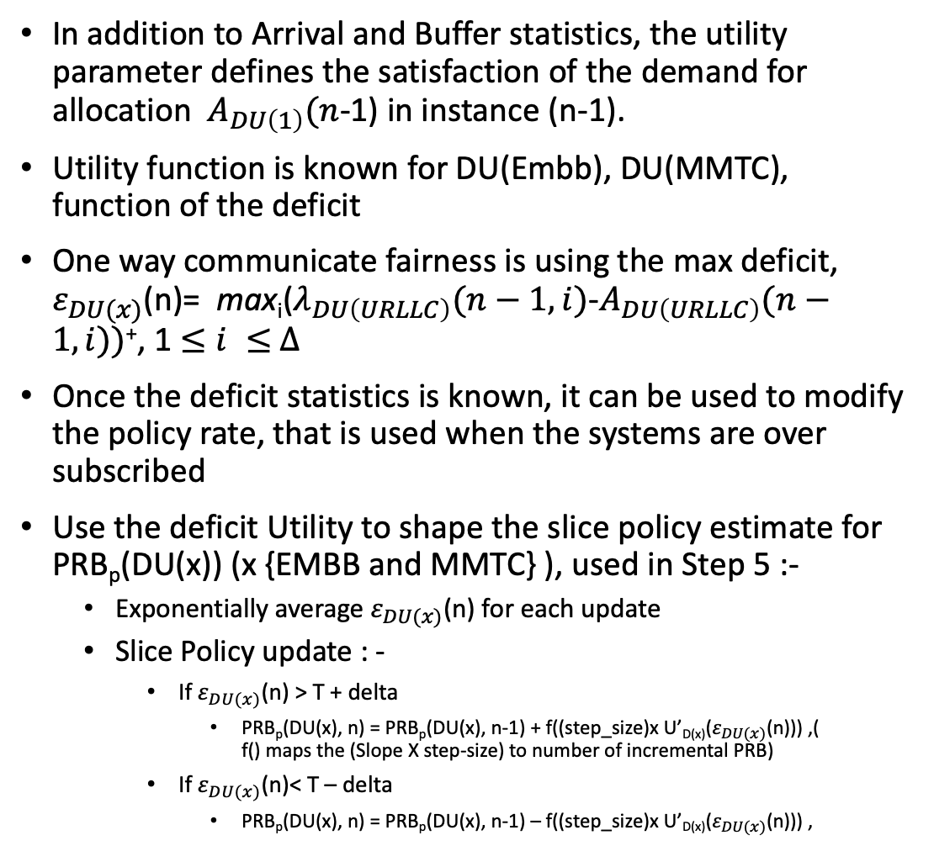

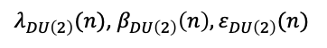

Considering DU System Utility
$λ_{DU\left(1\right)}(n)$, $β_{DU\left(1\right)}\left(n\right), ε_{DU\left(1\right)}(n)$
DU 1
DU URLLC
In addition to Arrival and Buffer statistics, the utility parameter defines the satisfaction of the demand for allocation $A_{DU\left(1\right)}(n$-1) in instance (n-1).
Utility function is known for DU(Embb), DU(MMTC), function of the deficit
One way communicate fairness is using the max deficit, $ε_{DU(x)}$(n)= $\text{max}\text{i}\text{(}λ_{DU\left(URLLC\right)}(n−1,i)\text{−}A_{DU\left(URLLC\right)}(n−1,i))\text{+}$, 1 $≤i ≤$ $∆$
Once the deficit statistics is known, it can be used to modify the policy rate, that is used when the systems are over subscribed
Use the deficit Utility to shape the slice policy estimate for PRB_{p}(DU(x)) (x {EMBB and MMTC} ), used in Step 5 :-
Exponentially average $ε_{DU(x)}$(n) for each update
Slice Policy update : -
If $ε_{DU(x)}$(n) > T + delta
PRB_{p}(DU(x), n) = PRB_{p}(DU(x), n-1) + f((step_size)x U’_{D(x)}($ε_{DU(x)}$(n))) ,( f() maps the (Slope X step-size) to number of incremental PRB)
If $ε_{DU(x)}$(n)< T – delta
PRB_{p}(DU(x), n) = PRB_{p}(DU(x), n-1) – f((step_size)x U’_{D(x)}($ε_{DU(x)}$(n))) ,
Slice RM
$$A_{DU\left(2\right)}(n+1)$$
$λ_{DU\left(2\right)}(n)$, $β_{DU\left(2\right)}\left(n\right),ε_{DU\left(2\right)}(n)$
DU 2
$$A_{DU\left(2\right)}(n+1)$$
--> Increasing deficit in each TTI in a DU results in increase of the loss function
U(Du(x), d)
T
Deficit(d)

Slide 17
Simulations

Slide 18
Simulation Objectives
Embb Sources
URLLC sources
RLC
RAN with a eNodeB with two schedulars, and serving two set of UEs – Embb and URLLC
Each Schedular serves Embb and other URLLC
A RB management entity that takes in Arrival and Buffer statistics every X TTI and returns the PRB allocation for the following X TTIs
The objective is to study the system under oversubscribed conditions to meet URLLC delay and PER requirements considering retransmissions.
For EMBB users, the quantification is w.r.t loss in throughput with increasing URLLC load
Traffic Stats.
RB Slice Mgmt.
MAC
Embb Schedular
URLLC Schedular
CQI(u)
PHY
CQI(u)

Slide 19
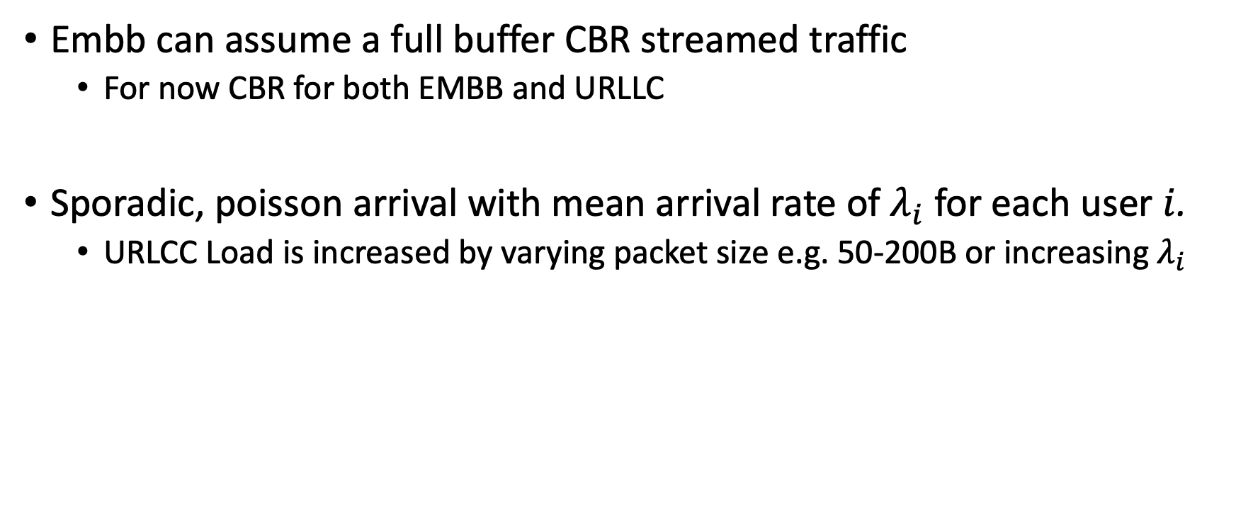
Traffic Model
Embb can assume a full buffer CBR streamed traffic
For now CBR for both EMBB and URLLC
Sporadic, poisson arrival with mean arrival rate of $λ_{i}$ for each user $i$.
URLCC Load is increased by varying packet size e.g. 50-200B or increasing $λ_{i}$

Slide 20
Simulation Settings
Single/Multi-cell network with randomly spread Embb and URLLC users
Static and Mobile
LTE/5G PHY layer settings
5g features such as , Variable timeslots/TTI , TDD configuration available with mmWave module
URLLC Minislot scheduling
NS-3 doesn’t have this yet

Slide 21
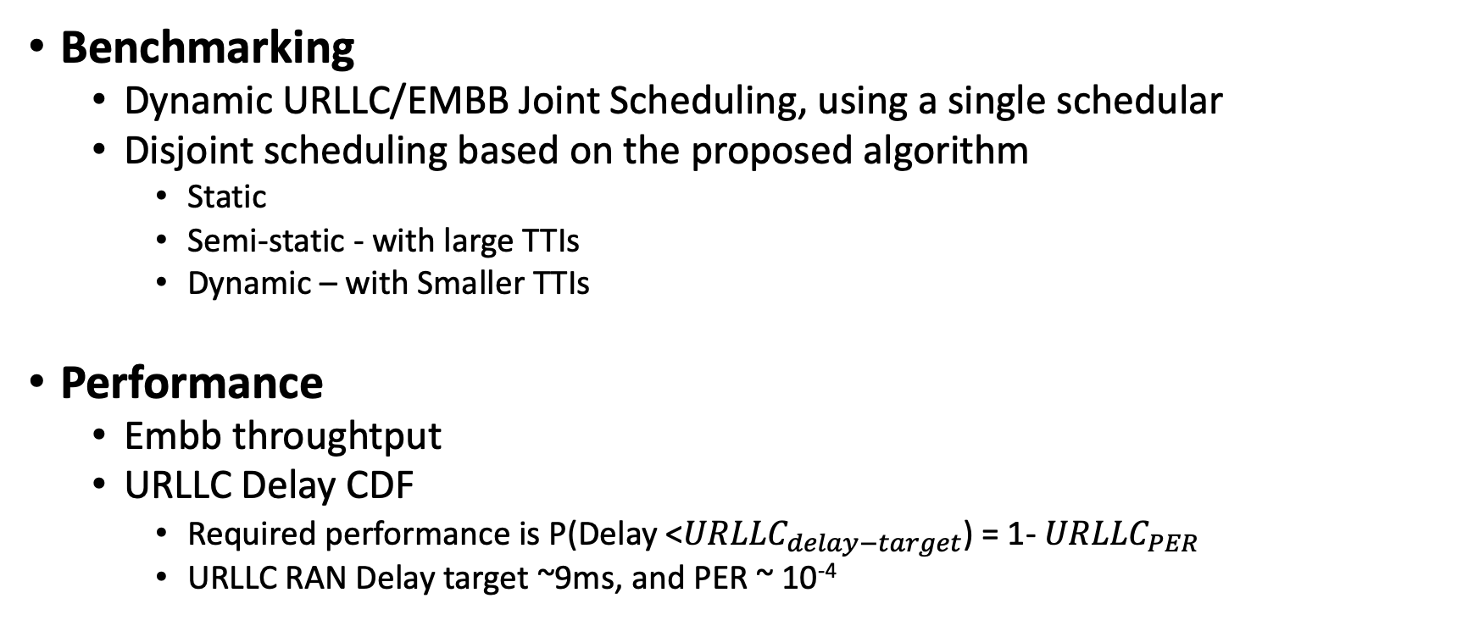
Benchmarking and Performance
Benchmarking
Dynamic URLLC/EMBB Joint Scheduling, using a single schedular
Disjoint scheduling based on the proposed algorithm
Static
Semi-static - with large TTIs
Dynamic – with Smaller TTIs
Performance
Embb throughtput
URLLC Delay CDF
Required performance is P(Delay <${URLLC}_{delay−target}$) = 1- ${URLLC}_{PER}$
URLLC RAN Delay target ~9ms, and PER ~ 10⁻⁴

Slide 22
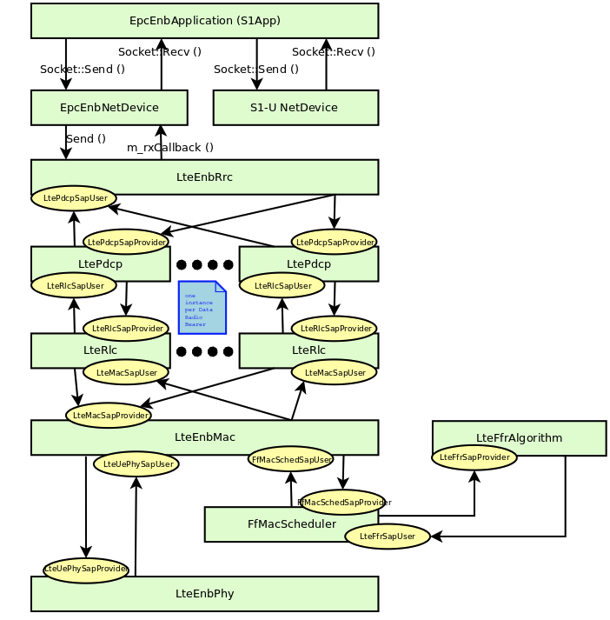
NS-3 LTE Module Changes
EnodebRRC
Userplane
MAC TM
SliceRB Manager
LteEnbMac
LteFfrAlgorithm
LteFfrAlgorithm
FfMacUrllcScheduler
FfMacScheduler(Embb)
LteEnbPhy
Have the two schedular basic framework up
URLLC RLC buffer stats and CQI goes Urllc Schdular
Embb RLC buffer stats and CQI goes Embb Schdular
RB Manager hasn’t been implemented yet

Slide 23
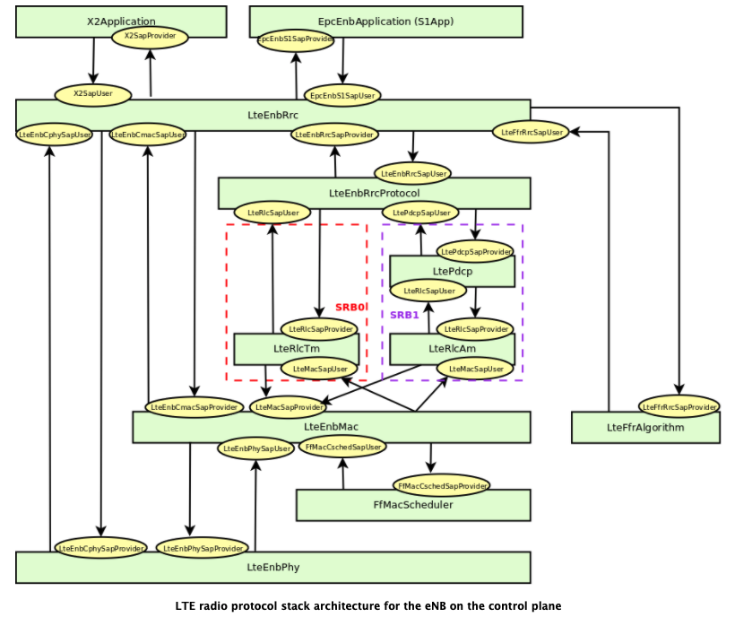
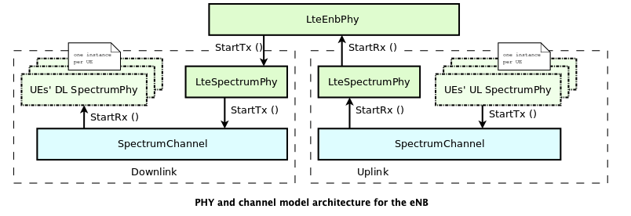
NS-3 LTE SW

Slide 24
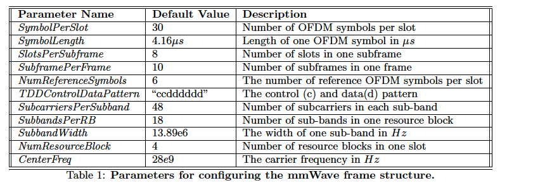
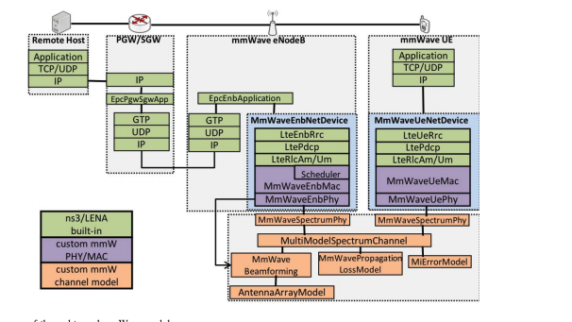
NS-/5G mmWave Module
Channel Modelling:
mmWave Propagation Loss- 3gpp/Tracing/Mathlab, LOS/NLOS, Outdoor/Indoor Model
MIMO
Beamforming
HARQ
RoundRobin/PF/EDF/Max Rate
Ref: https://par.nsf.gov/servlets/purl/10112885

Slide 25
Simulation Parameters
Embb/Urllc Scheduler "ns3::PfFfMacScheduler"
PathlossModel "ns3::FriisSpectrumPropagationLossModel"
FadingModel : No
Mobility Model : Constant Position
ns3::LteHelper::UsePdschForCqiGeneration=[true]
ns3::LteHelper::NumberOfComponentCarriers=[1]
# of UEs : 2
TTI : 1ms
Simulation time : 2s
UlBandwidth "25" (RBs)/5Mhz
DlBandwidth "25" (RBs)/5Mhz
DlEarfcn "100"
UlEarfcn "18100"
UeTxPower "10dbm"
UeNoiseFigure "9db"
EnbTxPower "30dbm"
EnbNoiseFigure "5db"

Slide 26
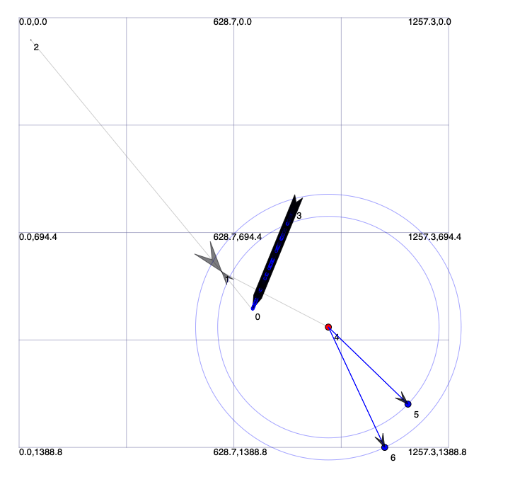

Simulation Topology
Server
SGw
EnodeB
PGw
Embb UE
Urllc UE

Slide 27
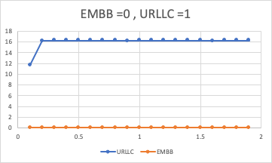
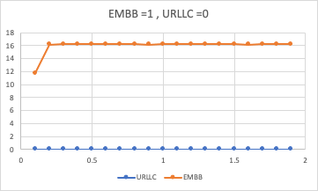
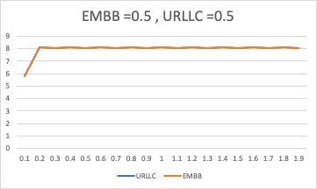
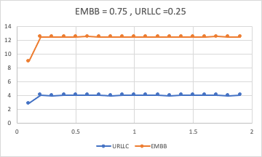
Results

Slide 28
RBG Control Function
UE-1 flow
…
UE-2 flow
RLC
ReportBufferUpdate()
MAC
V
ExecuteRBManagement
(UE Traffic Statics, X*TTI, Embb Policy Resv.){ Smoothing/Prediction/RB distribution; returns RB-Allocation}
Real time UE Buffer Stats
DoSchedDlConfigInd()
SetBlockedRbgs()
SetBlockedRbgs()
URLLC Schedular
URLLCBlockedRBG
Embb Schedular
EmbbBlockedRBGs
Data
SchedulingTrigger/TTI
ReadBlockedRbgs()
ReadBlockedRbgs()
DoScheduleDlTriggerReq()
DoScheduleDlTriggerReq()
SchedDlCqiInfoReq()
PHY

Slide 29
Simulation Settings
RB Control Frequency : {10, 5} TTIs
Exponential averaging time-window parameter : 99, alpha ~ 0.989
Minimum Embb Policy Rbg Size : {0, 1, 3}
Traffic : Full Buffer Model

Slide 30
Case 1 : Congested Mode, with Embb Policy Reservation =0
CBR URLLC + CBR EMBB >> Cell capacity
RB Control Frequency : 5 TTIs
Embb Policy Reservation =0
URLLC Througput ~[16] Mbps
Embb Throughput ~[0 Mbps]
RBG allocation for URLLC ~ [12]
RBG Allocation for Embb ~[0]
Max Embb HOL Delay :Unbounded
Max URLLC HOL Delay ~[4]ns
-> Embb UE is not receiving data, so no data points

Slide 31
Case 1(a) : Congested Mode, with Embb Policy Reservation =2
CBR URLLC + CBR EMBB >> Cell capacity
RB Control Frequency : 5 TTIs
Embb Policy Reservation =2
URLLC Througput ~[14] Mbps
Embb Throughput ~[2.5 Mbps]
RBG allocation for URLLC ~ [10]
RBG Allocation for Embb ~[2]
Max Embb HOL Delay :25ns
Max URLLC HOL Delay ~[5]ns

Slide 32
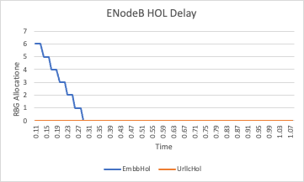
Case 1: Un-congested Mode
CBR URLLC + CBR EMBB ~= Cell capacity
RB Control Frequency : 5 TTIs
Embb Policy Reservation =0
URLLC Througput ~[16] Mbps
Embb Throughput ~[0 Mbps]
RBG allocation for URLLC ~ [12]
RBG Allocation for Embb ~[0]
Max Embb HOL Delay :Unbounded
Max URLLC HOL Delay ~[4]ns

Slide 33
Changing the periodicity of RB Mgmt. execution.
CBR URLLC + CBR EMBB ~= Cell capacity
RB Control Frequency : 5 TTIs
Embb Policy Reservation =0
URLLC Througput ~[16] Mbps
Embb Throughput ~[0 Mbps]
RBG allocation for URLLC ~ [12]
RBG Allocation for Embb ~[0]
Max Embb HOL Delay :Unbounded
Max URLLC HOL Delay ~[4]ns

Slide 34
RB Distribution every 5*TTI RB, and Embb Resv. =0
Full Buffer Model
RB Control Frequency : 5 TTIs
Embb Policy Reservation =0
URLLC Througput ~[0] Mbps
Embb Throughput ~[16 Mbps]
RBG allocation for URLLC ~ [12]
RBG Allocation for Embb ~[0]
Max Embb HOL Delay :Unbounded
Max URLLC HOL Delay ~[0]ns

Slide 35
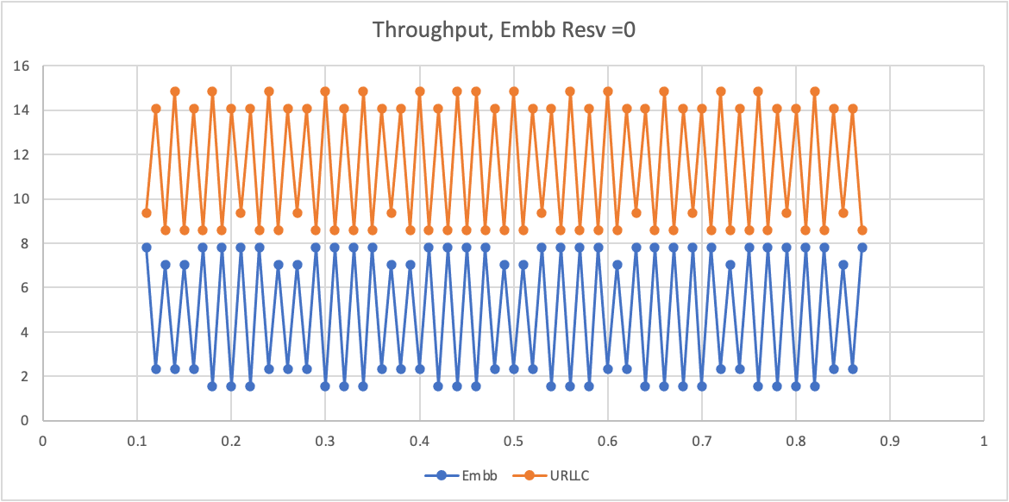
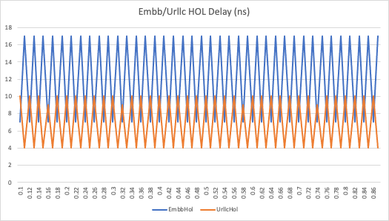
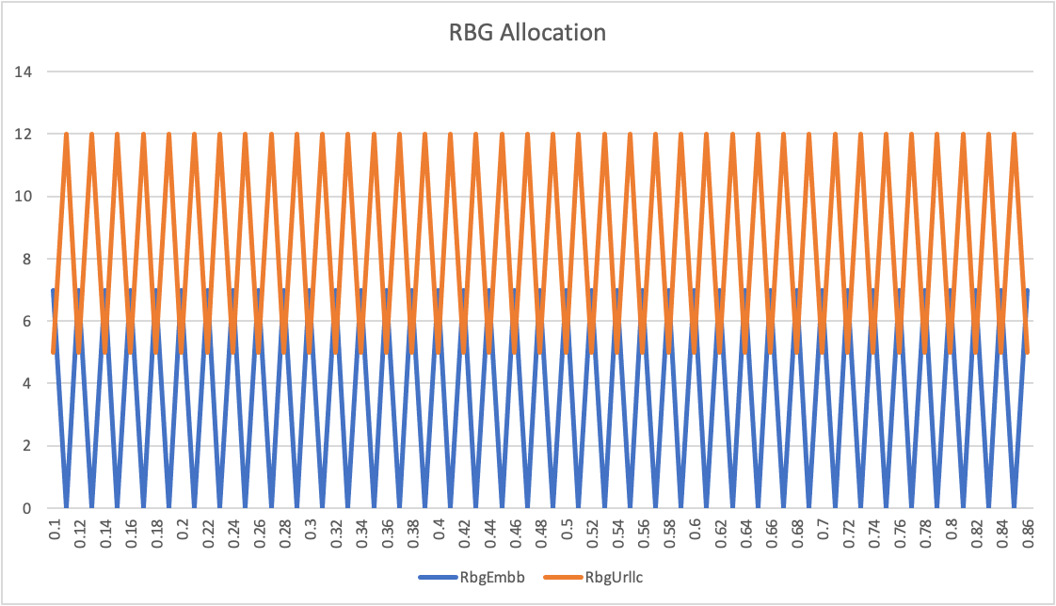
Full Buffer Model
RB Control Frequency : 10 TTIs
Embb Policy Reservation =0
URLLC Througput ~[9-15] Mbps
Embb Throughput ~[1-8Mbps]
RBG allocation for URLLC ~ [5,12]
RBG Allocation for Embb ~[0,7]
Max Embb HOL Delay ~[8- 17] ns
Max URLLC HOL Delay ~[0-10]ns
The performance is sensitive to the frequency of executing the RB distribution algorithm
Possible reason :
Longer TTI duration allows the URLLC queue to drain fast enough to allow residual RBGs to be given to Embb for transmission.
Smaller TTI control also reduces the HOL delay for URLLC, which is desirable

Slide 36
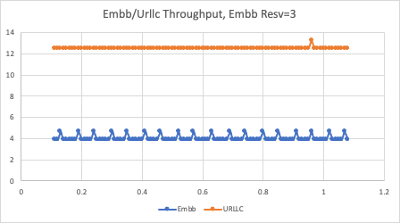
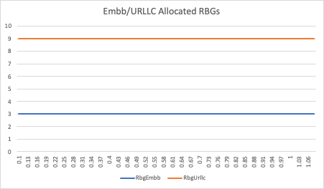
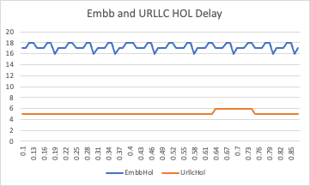
Full Buffer Model
RB Control Frequency : 10 TTIs
Embb Policy Reservation =3
URLLC Througput ~[12-13] Mbps
Embb Throughput ~[4-5Mbps]
RBG allocation for URLLC ~ [9]
RBG Allocation for Embb ~[3]
Max Embb HOL Delay ~[16-18] ns
Max URLLC HOL Delay ~[4-6]ns
With reservation, decreasing to 5*TTIs doesn’t change the allocation or the rate

Slide 37
10xTTI and With Resv=1
Longer TTI and lower reservation for Embb flows results in more throughput variation (similar to Slide 31), hence higher HOL delays.

Slide 38
Next Steps
Regenerate graphs, delay CDFs
Change the URLLC traffic model
Code to track the PDCP level packet delay and the CDF
More Cells and UEs, with mobility and HARQ
Benchmarking against Joint scheduling – haven’t seen this feature in NS-3 yet
We could implement it..

